Slide 1
Panoramic Photography
A Guide and bit of a Background
Panoramic Photography and Image Stitching

Slide 2
Why use Panorama Format
Big, Wide View
Beyond Square and Standard Image Sensor Ratios
Emotional Response. Cinematic. Dramatic
High Resolution images. Poster Prints, similar to 35mm enlargements.
  See Sydney Harbour image taken from a disposable panoramic camera
  See Next : Ferrari from Shoot For A Cause. Image stitching exercise

Slide 3
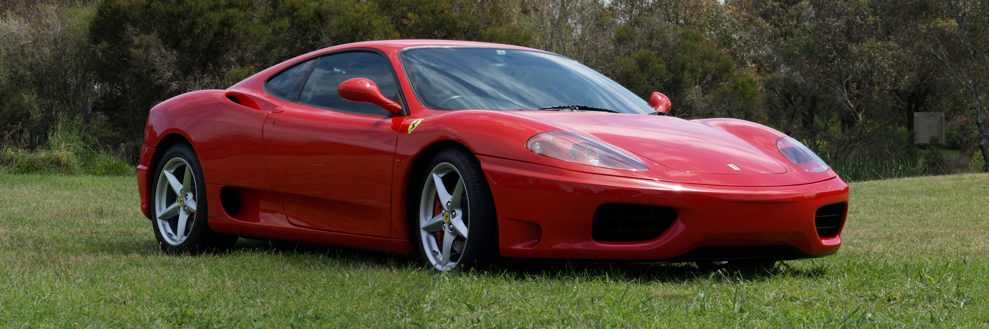
Panoramic Format. 10 Images Stitched

Slide 4
History
Cinema
  Widescreen was developed to compete with the introduction of television’s square screen, being seen in the home
  A commercial / marketing decision to differentiate cinema from TV and give people a reason to return / continue going to the cinema
Photography
  As long as photos have been taken
  Early panoramas were made by placing two or more daguerreotype plates side-by-side

Slide 5
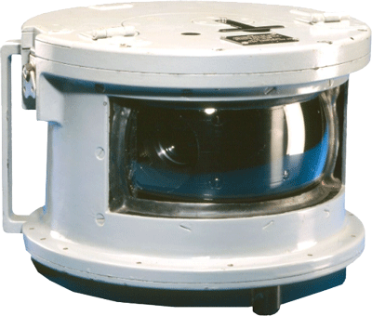
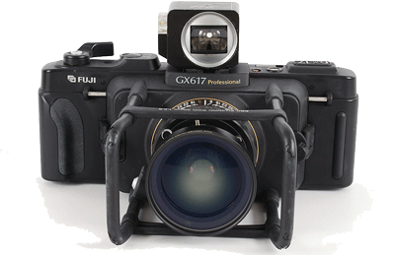
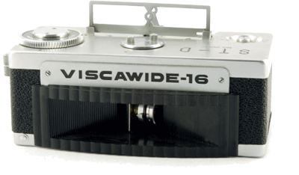
Equipment : Dedicated Cameras
Rolling Lens moves across the negative or sensor
Fuji 35mm Film
16mm Film
Underwater 35mm Film

Slide 6
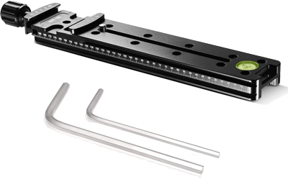
Equipment : Standard Cameras
Nodal Slides
  Moves the Nodal Point of the Lens over the centre point of the
  Tripod. This reduces Parallax Errors for close subjects

Slide 7
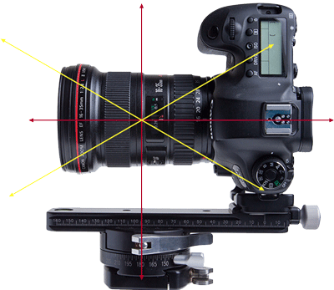
Explanation : Nodal Point
What is A Nodal Point?
  Where the Light from the Outside
  of the Lens Crosses Over and then
  projects an image on the
  sensor or film to be recorded

Slide 8
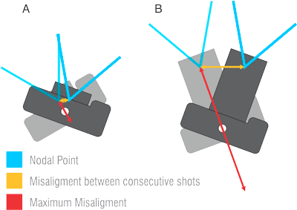
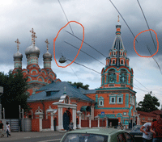
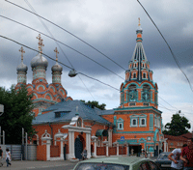
Explanation : Parallax Error
What is a Parallax Error
  An issue particularly for Close Up / Foreground subjects
  Caused by the relative appearance of objects between frames

Slide 9
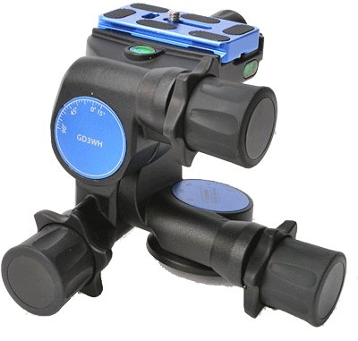
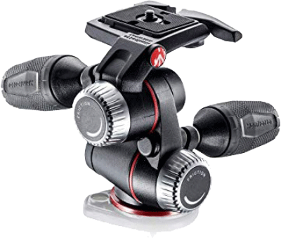
Equipment : Geared Heads
  Multi-axis movement (with indicators)
  To accurately reproduce the overlay of images
  Manfroto
    https://www.manfrotto.com/us-en/xpro-geared-three-way-pan-tilt-tripod-head-mhxpro-3wg/
  Arca Swiss
    https://www.arca-shop.de/en/panoramic/
  Sunwayfoto
    https://sunwayfoto.com.au/product-category/rails-slides/
    https://sunwayfoto.com.au/product-category/indexing-rotators/

Slide 10
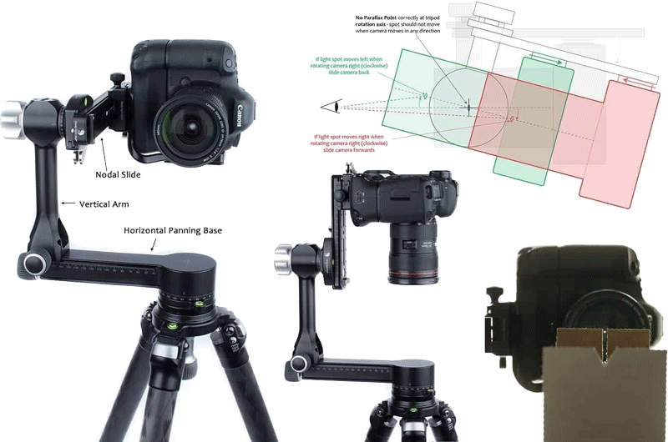
Equipment : Gimbals
  To allow flexible and easy positioning of the Nodal Point

Slide 11
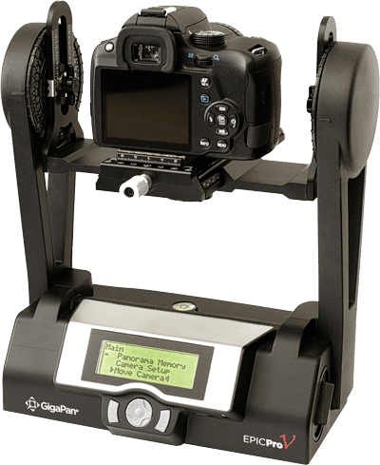
Equipment : Automated
Computer Controlled
Giga Pan : http://gigapan.com/
Operates Camera by
  Electrical Connection (tethered to controller pc)
  Manual Shutter Button depression
Rotates Camera on a Stepper Motor
Has software to stitch the images together
Results
  BLOODY Big Images (with Huge Mega Pixels)
  And lots of details
  http://www.gigapan.com/galleries/11203/gigapans/152220

Slide 12

Methods : Single Row
Horizontal
Vertical – More Pixels in Height

Slide 13
Methods : Multiple Rows : Z Pattern
LOTS more pixels. Higher Resolution Image. Increased Lens Flexibility

Slide 14
Considerations for taking Panoramic Images
Lock Focus
  One Focus Point or Focal Length
Lock White Balance
Lock Exposure
Overlap Images
  Minimum 40%. Maximum 70%
Level the Camera (Horizontal Plane)
  For consistency during rotating the camera
Shoot from the Horizon Level UP
  OR EQUALLY Below and Above the Horizon
  NOTE : Software may render on a polar grid causing distortions (TBC)
Time Between 1st and Last Image
  Check for Movement in Image (clouds, people, vehicles, etc.)
Display Aperture
  Size and Aspect Ratio etc.

Slide 15
Considerations
Subject
Lighting
Time between 1st and last image
Overflow – for cropping
Consistent overlapping of images
  For stitching
  Recommendations: 105 – 30%. Up to 50%
Story
Parallax Error
Indicators on Tripod
Nodal Point of lens
Focus Point
Aperture
White Balance

Slide 16
Software
Used to Stitch or Merge different images
Used to Crop to a particular format or size
Some software for making Panorama Images
  Adobe Photoshop and Lightroom
    https://www.adobe.com/au/creativecloud/plans.html
  GigaPan Stitch
    http://www.gigapan.com/cms/support/download-gigapan-stitch
  Hugin
    https://hugin.sourceforge.io/download/
  Panorama Stitcher Mini (Mac)
    https://www.panoramastitcher.com/
  PTGUI Pro
    https://ptgui.com/download.html

Slide 17
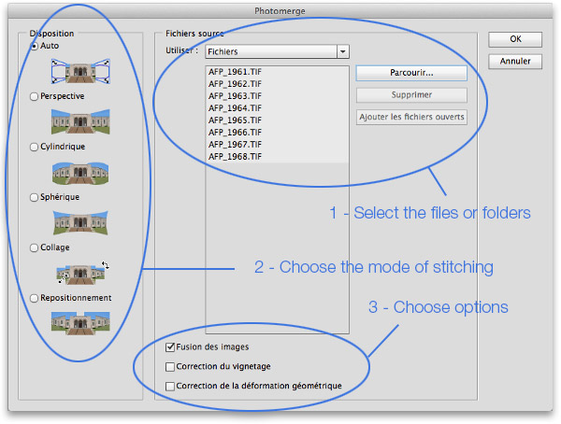
Software : Adobe PhotoShop : Photomerge
Photoshop

Slide 18
Ratio(s)
Widescreen Cinema has usually been based on 35mm film dimensions
Example of Polyvision 4:1
  Kiesza - What Is Love (Official Video)
  https://www.youtube.com/watch?v=Y-01dsXDqGE
Further Reading
  Aspect ratio (image)
  https://en.wikipedia.org/wiki/Aspect_ratio_(image)#2.00:1,_2.20:1,_2.35:1,_2.39:1,_2.40:1,_2.55:1,_2.76:1_and_21:9_standard_widescreen

Slide 19
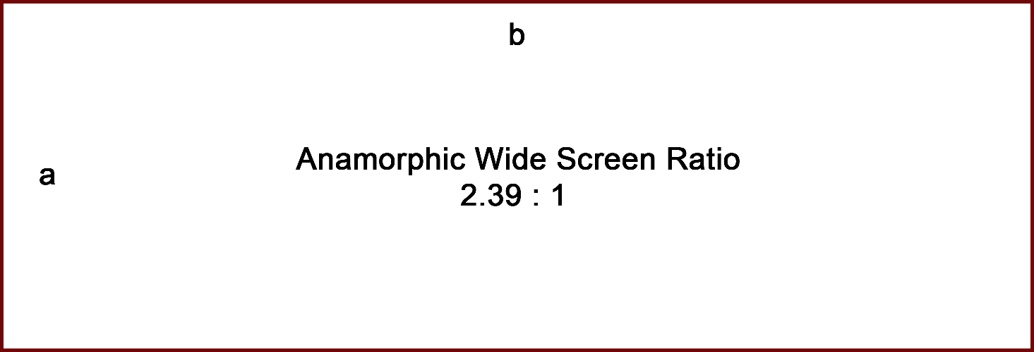
Ratio : Anamorphic : Cinematic

Slide 20

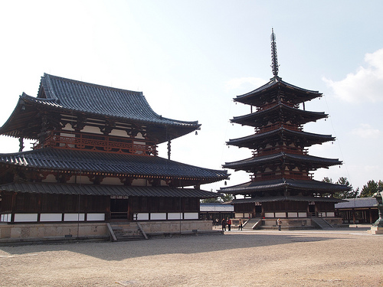
Ratio : Silver

Slide 21
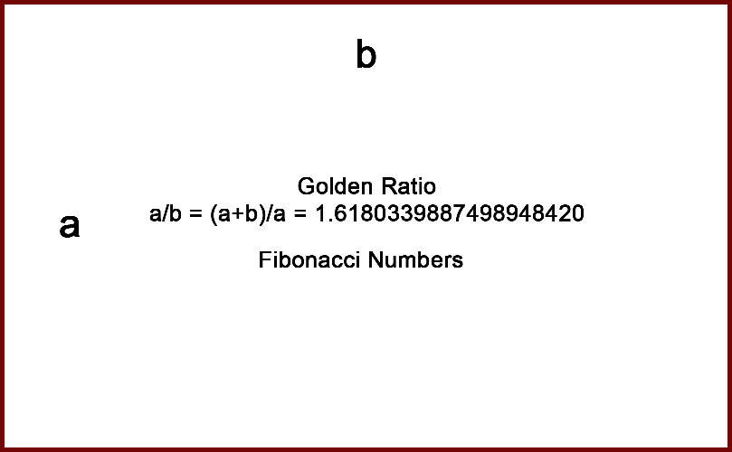
Ratio : Golden

Slide 22
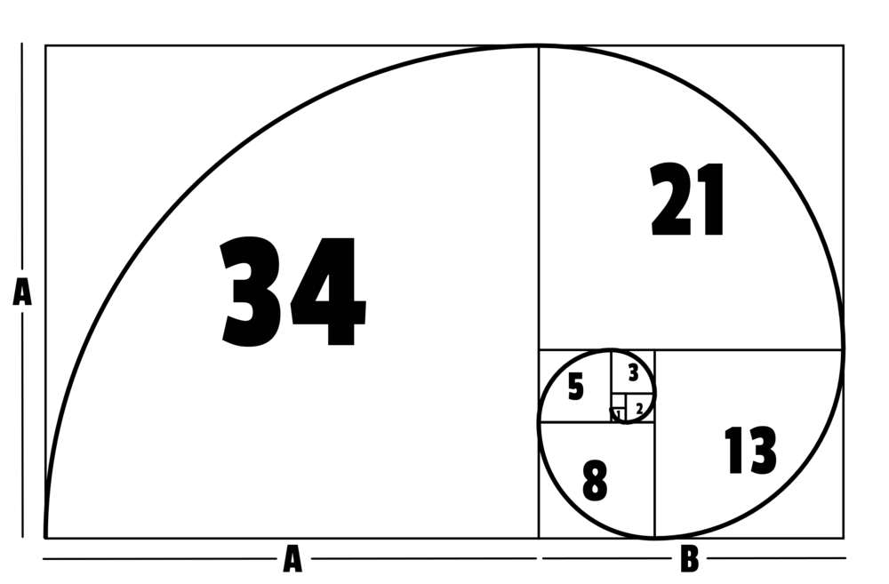
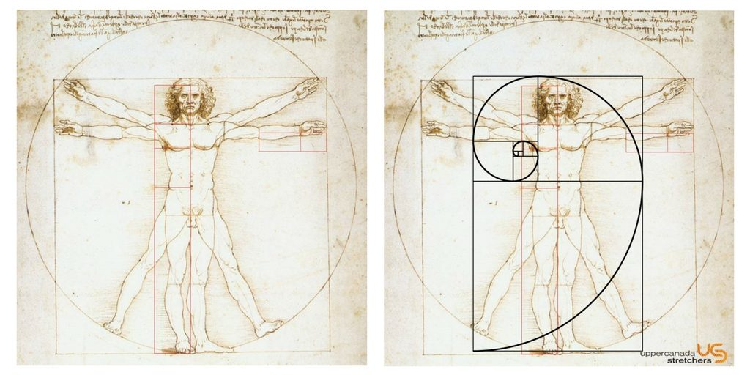

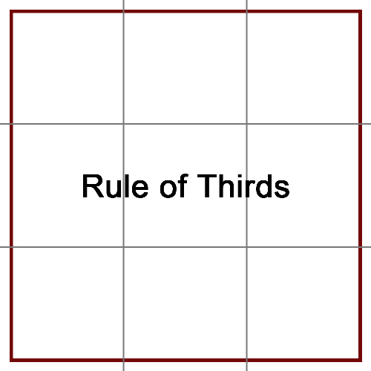
Ratio : Golden
The Golden Ratio is often
found and replicated in nature
Vitruvian Man
Leonardo Davinci
Further Reading
https://en.wikipedia.org/wiki/Golden_ratio
https://www.adobe.com/creativecloud/design/discover/golden-ratio.html

Slide 23

Rule of : Seven’s : New Composition Rules
Building on from the numbers…
Rule of Seven’s. Still a Prime Number. Still an Odd Number.
Odd numbers seem to be ‘visually pleasing’ to people

Slide 24
Panorama Images
Soma samples of image stitching

Slide 25
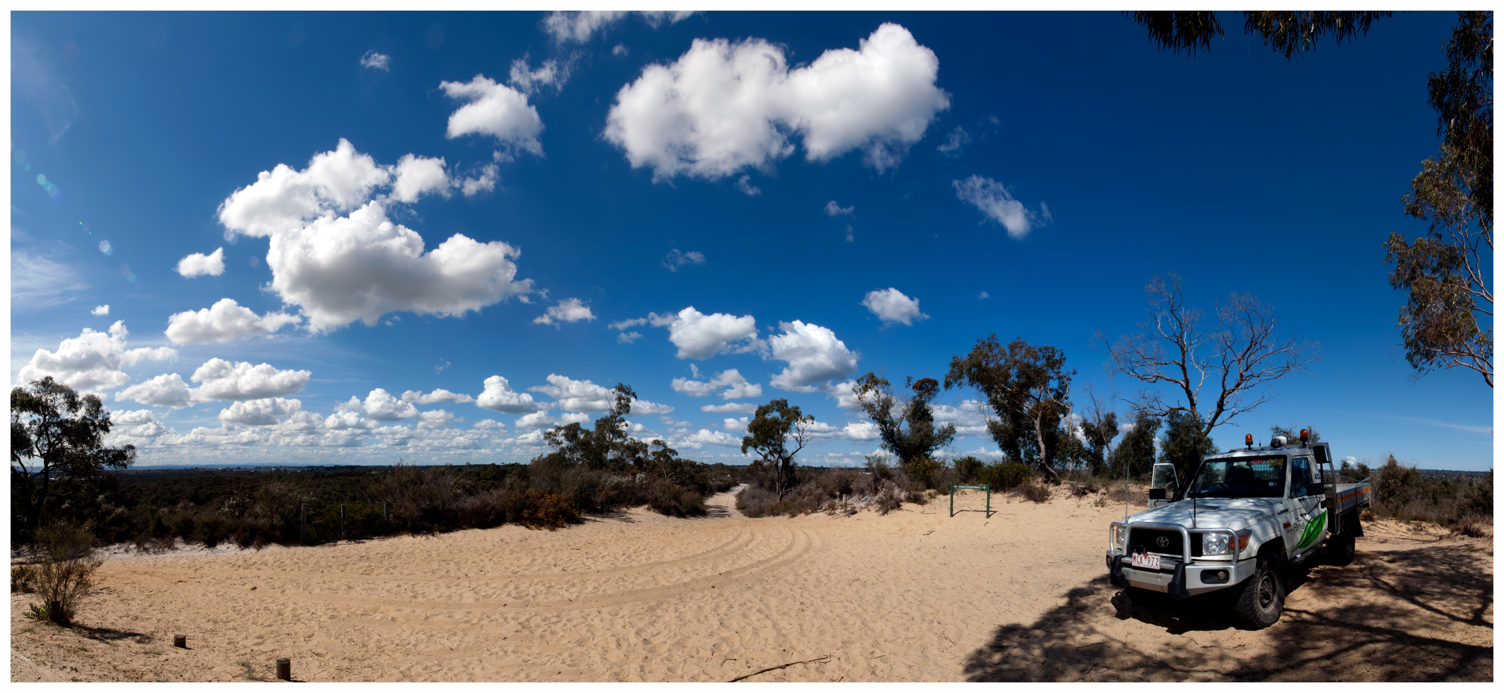
Pines Flora and Fauna Reserve : Frankston
Pines Flora and Fauna Reserve : 10 images stitched

Slide 26
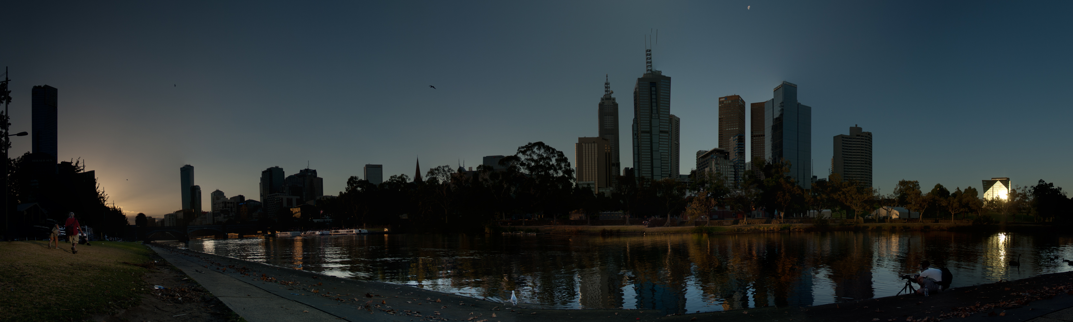
Yarra River Sunset : Melbourne
Yarra River at Sunset : ~ 50 images stitched

Slide 27
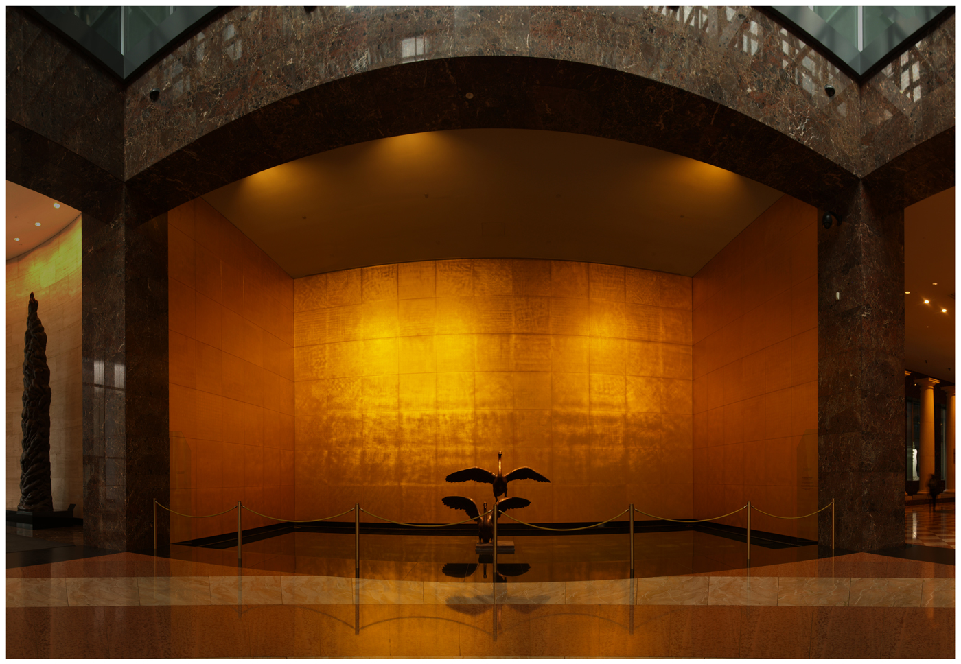
Golden
Contemplation
Pools
Melbourne
101 Collins Street : Gold Plated Contemplation Pool : distortions. ~ 40 images

Slide 28

Shelly Beach : Portsea
A trip on the Pier at Shelley’s Beach, Portsea. Cropped. Silver ratio. Rule of 7’s

Slide 29
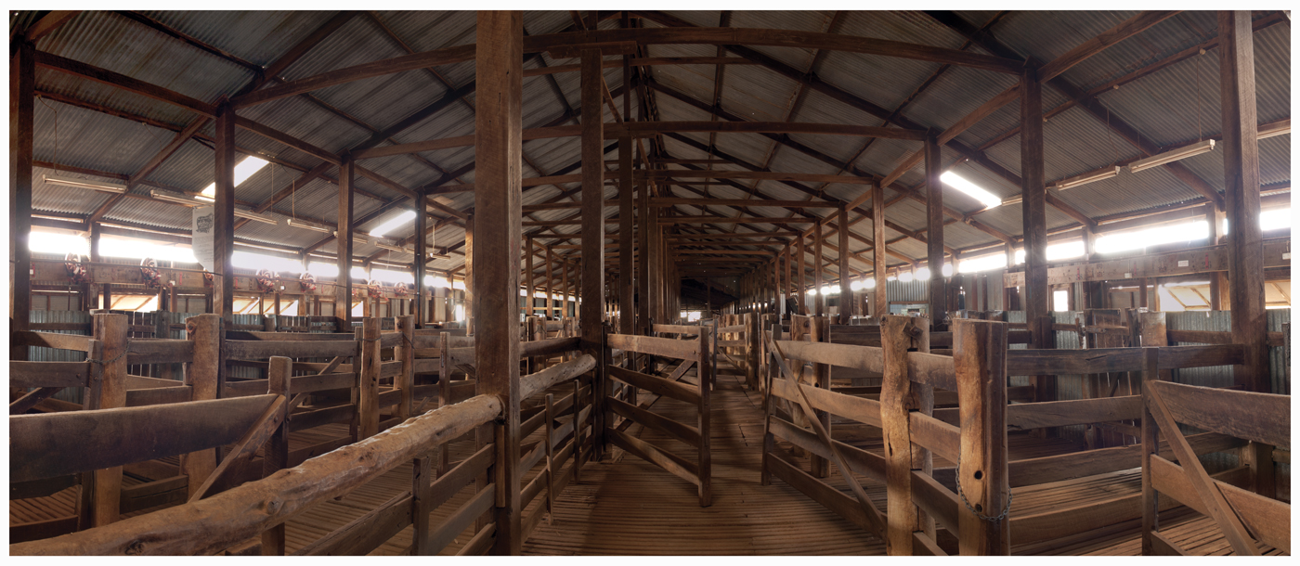
Shearing Shed : Balranald
Woolshed at Balranald. Lake Mungo trip. 25 Images stitched

Slide 30

Plane Underwater : Truk Lagoon
Sunken Plane at Truk Lagoon. Cropped. Rule of 7’s

Slide 31
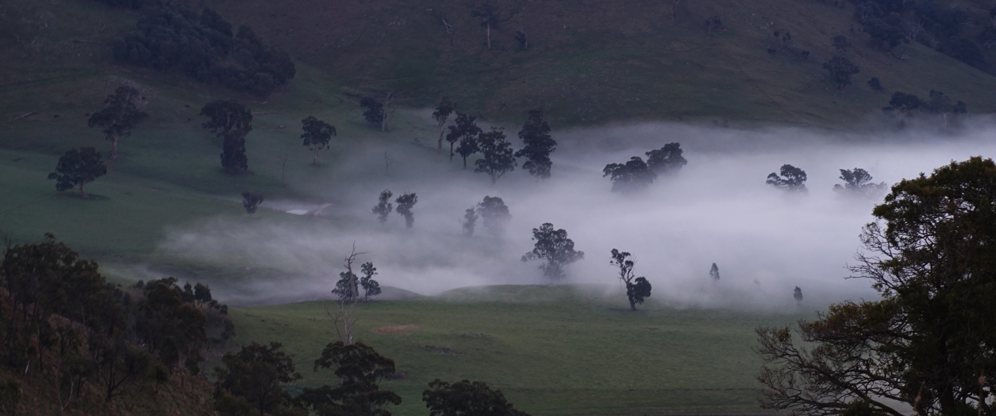
Nutfield : Molesworth
Fog Coming Up The Valley. Cropped. Silver Ratio. Rule of 7’s.

Slide 32
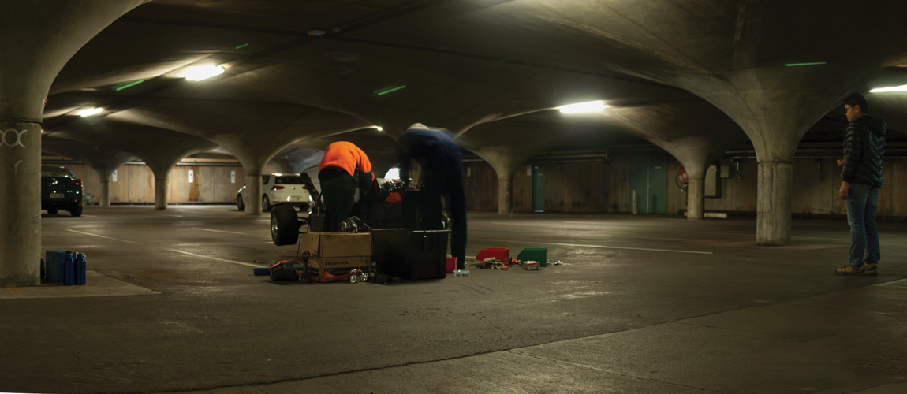
Melbourne University Underground Carpark
Melbourne University Carpark. Scene from Mad Max. Melbourne Uni Engineering Students. ~ 20 images stitched

Slide 33
References
A Brief History of Panoramic Photography
  https://www.loc.gov/collections/panoramic-photographs/articles-and-essays/a-brief-history-of-panoramic-photography/
Australian Photography : Wide, wider, widest – A history of panoramic cameras
  http://www.australianphotography.com/news/wide-wider-widest-a-history-of-panoramic-cameras#GS4TTVHRHQiFr6fi.99
Martin Bailey Photography : Shooting for Stitched Panoramas & Avoiding Parallax Shift (Podcast 452)
  https://martinbaileyphotography.com/2014/12/14/shooting-for-stitched-panoramas-avoiding-parallax-shift-podcast-452/
Really Right Stuff : Eliminate Parallax
  https://www.reallyrightstuff.com/eliminate-parallax
The Perfect Panorama : Top Panorama Problem #4: Stitching Errors
  http://www.theperfectpanorama.com/articles/problem-4-stitching.html
SmugMug : Finding the nodal Point of your Lens
  https://dgrin.smugmug.com/Tutorials/Shooting-Tech-and-Tips/Finding-The-Nodal-Point-of/

Slide 34
Reference : Continued
You Tube : Secrets of Shooting and Retouching Urban Landscapes - PLP #103 by Serge Ramelli
  https://www.youtube.com/watch?v=zJOg_DdklwQ&feature=em-uploademail
Adobe : Create panoramic images with Photomerge
  https://helpx.adobe.com/au/photoshop/using/create-panoramic-images-photomerge.html
Have Camera Will Travel : Best Panorama Software for Stitching Images
  https://havecamerawilltravel.com/photographer/panorama-stitching-best-apps/
Wikipedia : Silver Ratio
  https://en.wikipedia.org/wiki/Silver_ratio
Wikipedia : Golden Ratio
  https://en.wikipedia.org/wiki/Golden_ratio
Japan Style : The Silver Ratio and Japan
  http://www.japanstyle.info/08/entry20628.html

Slide 35
Techniques – hand held
Guestimate
Use reference in subject
Rotate camera around same
  Pivot point
  Rotational axis
Let software do the hard work

Slide 36
Techniques - Tripod
Tools
  Panoramic Photo Nodal slide
  Geared Head (repeatable accuracy for overlapping)
    Manfroto, Arca Swiss, Sunwayfoto,

Slide 37
Introduction
Why
How
History
Considerations
Techniques
Tools – Hardware
Tools – Software
Display Aperture
References

