Slide 1
Amanda’s Coastal Camp Ground
Using Digital Marketing Analytics and Insights
Why It’s Important and How it can be used
Notes:
This is the Final Project for the RMIT Short Course on Marketing Analytics.
Your project must address each of the questions below:
1) How can data be used to enhance your ability to deliver the right message,
to the right person at the right time?
2) Explain the difference between data as a metric and data as a commodity
and how Amanda could use each type of data in her marketing efforts.
3) Explain what is meant by ‘big data’ and demonstrate the idea of
correlation vs causation in marketing data.
4) Outline the difference between known and unknown data and
explain how a marketer might go about translating unknown to known.
5) What’s the difference between first, second and third party data and
how can a marketer use all three to gain valuable customer insights
in order to produce personalised marketing tactics?
6) Outline some of the benefits and challenges with 1:1 communication for marketers.
7) Incorporate data visualisations and narrative in your presentation.

Slide 2
Amanda Gave us Background and Context
Amanda is the new Owner and Manager of the Amanda’s Coastal Camp Ground.
She has never run a business before.
Has invested reasonably large amount, as this is her Sea-Change occupation before full retirement.
Has a large loan with a bank and is happy the interest rates are still low, but is concerned they will rise soon.
Is concerned about costs of advertising with on Online Travel Agency after Dick Smith’s commentary about commissions and money going overseas
The previous owners had
Been long time owners and sold to retire.
Renovated the facilities several years ago. They are still neat and clean. So Amanda doesn’t have to renovate for quite some time
Maintained the campground mostly by themselves. Except for the renovations a couple of years ago where the had builders come in.
Mainly a paper based administration and marketing system.
Sold the business while it was still making enough money to comfortably live on.
A slow but steady decline in overall customers coming through the doors.
Long sessions during Off-Peak season (Winter) where occupancy was low <50% at times.
Peak Season occupancy between 98% - 104%, which put a strain on the owners due to lack of resources.
Stays during the Off-Peak season were mainly over-night stays only.
Some long time customers they considered friends, who returned regularly.
An old basic website (because they needed one) that needed updating.
Joined the local tourism associations for networking opportunities.
DL brochures they distributed to local shops and tourist information centres around the peninsula and through wider state centres.
Picked up 20 O-Bikes cheap from an auction, with software and PIN Codes. Operating for the last months

Slide 3
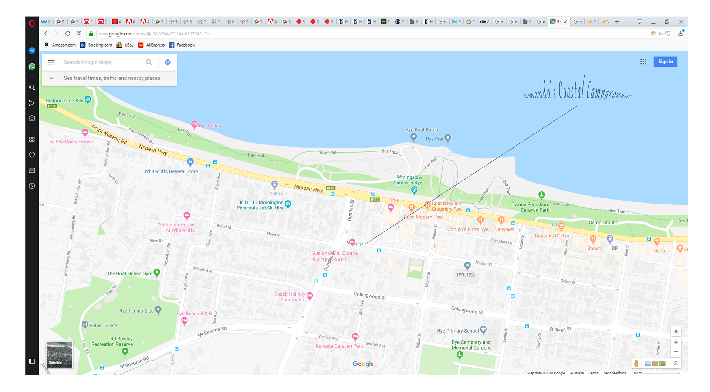
Background and Context (continued)
Amanda’s Coastal Campground is not far from shops, beach and amenities. Short walking or riding distance.

Slide 4
We will go over
What information Amanda already has that we can use to help her
Including what was left behind by the previous owners
What she has implemented since taking over the campground
What she may implement in future
Why this information is important and how we can use it
Finding any gaps and new opportunities
Having new ways of measuring her success across digital platforms
managing the increase in delivery and marketing channels now available
Suggest what may and may not be able to be done ‘in-house’
Important for managing constraints and budgets : $$ vs Time etc

Slide 5
What Amanda has to help us
Amanda has completed an audit of her current and potential marketing assets.
The website was updated to a Content Management System
To provide increased flexibility and extra functionality if required
To lower cost of development (extra functionality is usually free, or low cost)
Easier to update content, pages and on-site SEO, which helps us to be found on Search Engines
Implemented Accounts for Analytics and Advertising on Google and Bing and Facebook
The last two years of booking ledger has been input into Excel for analysis ( see further on)
The information is in a consistant format and can be quickly and easily filtered
Basic and common Social Media accounts have been registered and claimed
Facebook, InstaGram, Twitter, LinkedIn, YouTube, etc
This was recommended for Brand Protection as well as required marketing channels
Registered: www.amandascoastalcampground.com and .com.au for the same reason
Registered the camping ground details on free online directories
Has a list of the association memberships that the previous owners had
Has 20 O-Bikes with tracking software and PIN’s
Has started to look at affiliating the campground with other local businesses
Is considering some other local associations, listing sites and search technologies
Has heard of some other sites, but is a bit overwhelmed at the moment and is not yet considering those

Slide 6

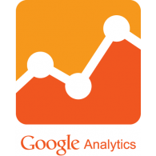
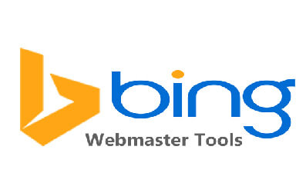






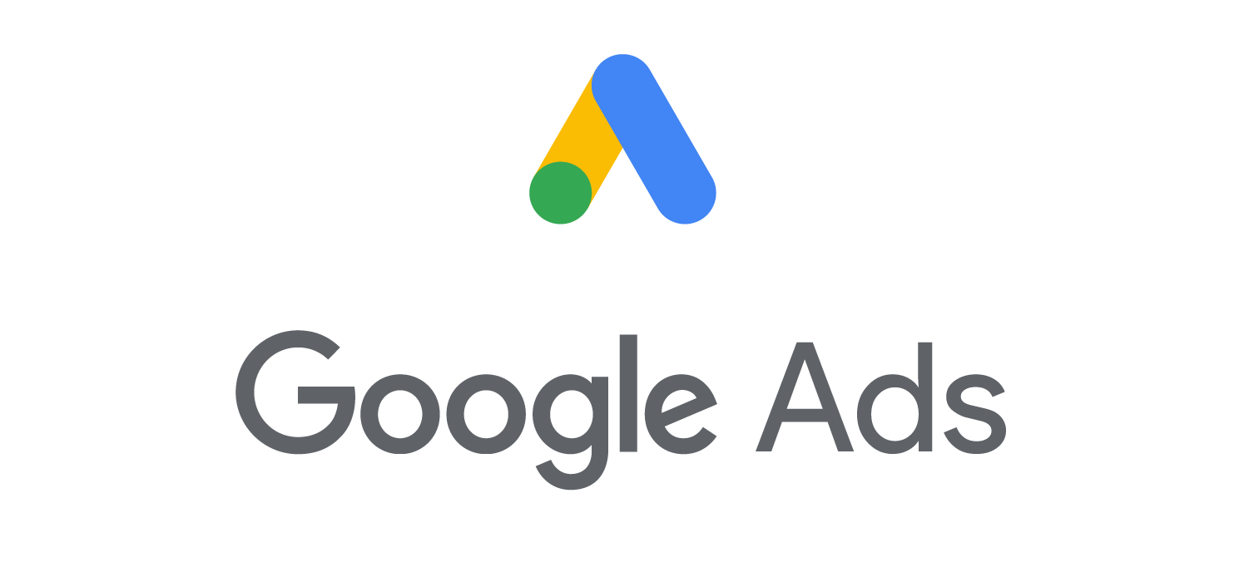






























An overview of Amanda’s data sources
website
Accounts : Web Analytics
Contact Form
Email
Accounts : Advertising
DL Brochures
Excel
Social Media Accounts
Potential Affiliates
Location Tracking
Free Online Directories
Options - Considering
Local Associations
Not Yet Considered

Slide 7
Amanda’s Paper Ledger Conversion
Amanda summarised week by week numbers for the past 2 years into Excel
Average Temperature
Number of Events (Calendar)
Not which type of events
Number of Families
Number of people in each family
Number of Groups
Number of people in each group
Number of Cabins booked
There are 12 in total
Number of Camp Sites booked
There are 30 in total
Converting to a digital format allows for
Easy manipulation and filtering
Trends and Insights to be easily discovered

Slide 8
Trend : Reduced Occupancy over 2 years

Slide 9
Trend : Less Families, Groups over 2 years

Slide 10
Trend : Less Events, Less % Occupancy

Slide 11
We can use the Occupancy metrics
Discover Trends and Insights
Trending downwards
Total % Occupancy Rate
Total Number of Families
Total Number of Groups
Total Number of Events
However, at this stage, we are unsure if the Number of Events is
A CAUSE of the reduced Occupancy Rate OR
Simply CORRELATED to the reduced Occupancy Rate. Is there something else we may have missed?
NOTE: The number of Families AND Groups has also reduced over time…
This decline is a direct cause of lower occupancy rate
Either way, we need to help Amanda increase her occupancy rate
NOTE:
If Amanda cannot impact the number of events being held around her local area to attract new customers, she will need to find more customers another way.

Slide 12
Why is this information important
Amanda owns this information, so this data is considered her 1st Party Data
She has used this data as a metric to measure and display trends and performance

Slide 13
We can use the metrics from the website
Using basic metrics
Time on Page
Bounce Rate
Page Visited
Where the user came from
If they scrolled
If the entered any data in fields on forms

Slide 14
Why is this information important
This is Amanda’s 1st Party data
Any interactions give us insights into
optimising our website, marketing assets and messages
to better align with the customers we want to attract

Slide 15
How we can help Amanda
From the information Amanda now has, we can suggest to
Add Remarketing tags to the website
Tagging and Cookies can identify interactions on our website
The identify of the user is only known by their interactions
Remarketing is used to keep Amanda’s Campground offers in front of potential customers
We can also track where the unknown customers have come from (search, social media etc)
This 1:1 marketing is made available through data driven marketing
Add new landing pages to the website
That match the activities the campground customers are looking for
Optimised for organise SEO (to help reduce paid advertising)
Optimised to meet the customer’s expectation when they select a link from Advertisements
With CALL TO ACTION to make a booking or subscribe
To make unknown data (customers details), known
Develop Ads for Ad Platforms that are linked to the new landing pages
Look at platforms and applications to automate delivery based on channel type
Suggest marketing to particular, potentially profitable audience segment

Slide 16
We can use the data from the O-Bikes
To see where campground customers are going and when
If Amanda cannot impact the number of local events, she can partner with other local businesses to increase her occupancy rates
However, she needs to determine which potential affiliate is a good fit.
Amanda summarised O-Bikes data tracking customer shop visits
The data was summarised for the previous 12 months.
Males and females are also summarised, but not age

Slide 17
O-Bike Data - Male

Slide 18
O-Bike Data - Female

Slide 19
O-Bike Tracking Data Summary
More visits by males compared to females
Peninsula Hot Springs
Peninsula Studio Trail
More visits by males, with noticeable female interest
Gunnamatta Horse Trails
Dive Victoria
Visited by both males and females about the same
Mornington Peninsula Wineries
Extreme Watersports
Red Hill Mountain Bike Riders
Some of the findings seemed a bit counter intuitive

Slide 20
Why is this information important
This is some of Amanda’s 1st Party Data
This can be used for customer insights
Help personalise website and ad content
Help to predict future patterns
We have some basic segments to start marketing to
Couple activities. Some active, Some passive
Males looking to arrange activities that women also participate
Males arranging activities to take females (romantic activities)

Slide 21
How can we help Amanda
We now have an idea of who to contact for their customer database
We can now negotiate for their 1st Party Data
Any affiliate 1st Party data is considered Amanda’s 2nd Party Data
We can use 2nd Party data to
Gain audience insights
Predict future patterns
Personalise website and ads
Amanda is now starting to use data as a commodity to trade

Slide 22
We can use Social Media Metrics
Social Media have unique user ID, based on their registration details
Each of these can form a profile of interactions (likes, follows, clicks etc)
As the account registration details have known data attributes
Specific Audience Categories and Segments can be developed
These can help us to target specific messages based on platform

Slide 23
Best times to target marketing channels (1)
Facebook
Better off posting towards the end of the week.
18 % better engagement Thursdays and Fridays. 32% better engagement on weekends
Best times to post are between 7.30am and 8.30am, 12pm and 2pm and 4.30pm and 6.30pm.
Twitter
Engagement for brands is 17% higher on weekends
Click-through rates are highest midweek on Wednesdays and on weekends.
Best times to tweet include 8am – 9.30am, 12pm – 2pm and 4.20pm and 5.30pm
Retweets are highest at 5pm
LinkedIn
Is more business focused than any of the others and more likely to also be visited during the day
Should consider posting at the start or the end of the working day

Slide 24
Best times to target marketing channels (2)
Instagram
More than 35% of photos are posted after 6pm. 6.17% of posts appear at midnight.
SMS Messaging
One of the most immediate channels available, with an open ratio of 97% within 15 minutes of delivery.
less is more – with success coming from just 4-6 SMS messages a month.
mobile phones are used most between noon and 6pm – the best time to send a sms marketing campaign is mid-late afternoon.
Email
Only 20% of emails actually get clicked on.
receives better response when sending out up to 30 campaigns a month.
Tuesdays and Thursdays are the best days to send out e-mails and
optimal time is 2pm

Slide 25
How can we help Amanda
To make it appear like Amanda is doing 1:1 marketing and personalising her messages to a specific audience member
We could align O-Bike visit data with message platform times
We can send a Facebook Ad on Friday afternoon about Peninsula Spas to Males
We could send a tweet about SCUBA Diving on Wednesday morning and afternoon to both Males and Females
We could send out emails on Tuesday afternoon to new customers suggesting offers and discounts at the campground and affiliates
We could also use retargeting to display ads to potential customers when they have interacted with the site, ads or social media platforms

Slide 26
Unknown to Known
When tags are implemented onto a website for a platform
Every interaction can be recorded
Every interaction can be attributed to a unique ID
The ID can be tracked across other websites and advertisements
This ID will build up a profile
However, until particular identifiable attributes are captured
The ID will only be a list of interactions
By aligning and optimising
Website landing pages
Advertisement collateral and assets
Message delivery platform and timing
There is a greater chance of Conversion (completing a booking form)
With the ID being associated with a person
Converting from unknown to known

Slide 27







Find More Customers with 3rd Party Data
Each unique ID will have a profile of interactions
Many ID’s will have similar interactions that can be
Categorised and separated into segments
Data Aggregators
Purchase 1st Party Data from a wide range of data providers
Usually specialising in a particular industry
Find commonalities in interactions
Onsell the segment data
If Amanda uses this data, it will her 3rd Party Data
Applications
Aggregated Data

Slide 28
Using 3rd Party Data
Can be used for
Extending audience reach
Combine with our 1st party data to generate better insights
Increase precision in Targetting (Ad platforms particularly)
Discover new audiences
Good to know…
Not all sources of the data are known
Categories and attributes may be inferred, not observed
Different Aggregator supply different Categories / Segments
Make sure you purchase from an appropriate aggregator
The data can be considered large scale Big Data
Applications
Aggregated Data

Slide 29
What we have to help Amanda
website
Accounts : Web Analytics
Applications
Contact Form
Email
Accounts : Advertising
DL Brochures
Excel
Social Media Accounts
Potential Affiliates
Location Tracking
Free Online Directories
Options - Considering
Aggregated Data
Local Associations
Not Yet Considered

Slide 30
Thank You

Slide 31
References
Dick Smith commenting on Online Travel Agencies, https://www.smartcompany.com.au/industries/tourism/dick-smith-motel-owners-slam-online-travel-agencies/
http://vennli.com/blog/how-to-use-customer-demographics-to-segment-markets-spoiler-alert-dont/, last accessed 201811.03
https://www.linkedin.com/pulse/from-unknown-known-customer-data-journey-matt-walter, last accessed 2018.11.03
http://www.segmentationstudyguide.com/segment-profiles/segment-profile-example/, last accessed 2018.11.03
https://www.cm.com/blog/timing-is-key-when-is-the-best-time-to-reach-your-audience/, last accessed 2018.11.03

